Slide 1
PRESENTATION ON THE PROJECT:
Submitted by: UTKRIST SINGH
Date: 08-AUG-2020
THE BATTLE OF NEIGHBOURHOODS

Slide 2
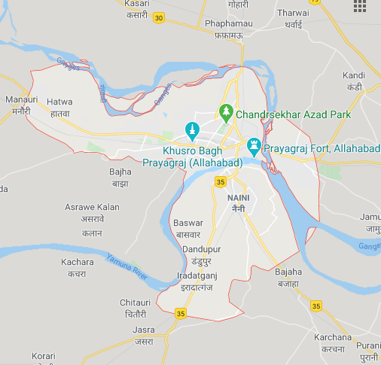
ALLAHABAD: IN MAP

Slide 3

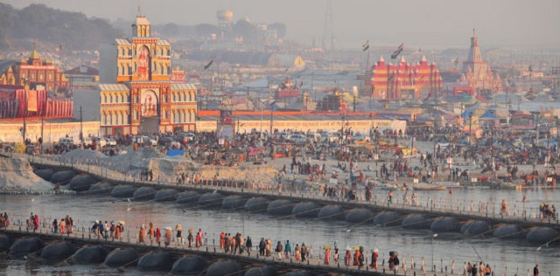


OVERVIEW

Slide 4
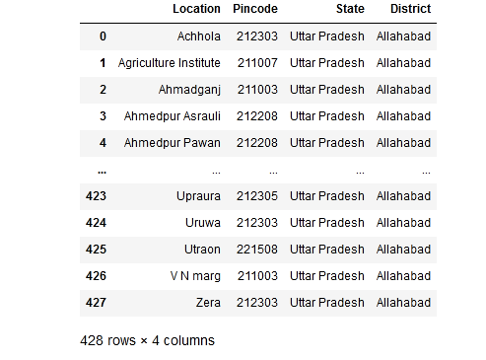
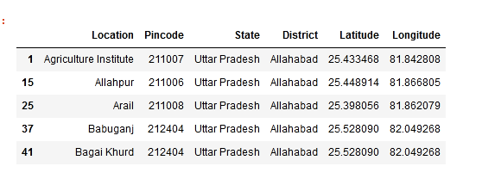
DATA IMPORTED: OVERVIEW
FOURSQUARE

Slide 5
FOURSQUARE API
The Foursquare API allows application developers to interact with the Foursquare platform. The API itself is a RESTful set of addresses to which you can send requests, so there's really nothing to download onto your server. That being said, in this article, you use a set of PHP libraries to help simplify requests and responses, but this is an entirely optional step.
You can currently request output in XML or JSON format, making requests to URLs that look like this: http://api.foursquare.com/v1/user.json. If you don't use an extension on your request, then XML is served back to you. A request to http://api.foursquare.com/v1/user results in an XML output.

Slide 6
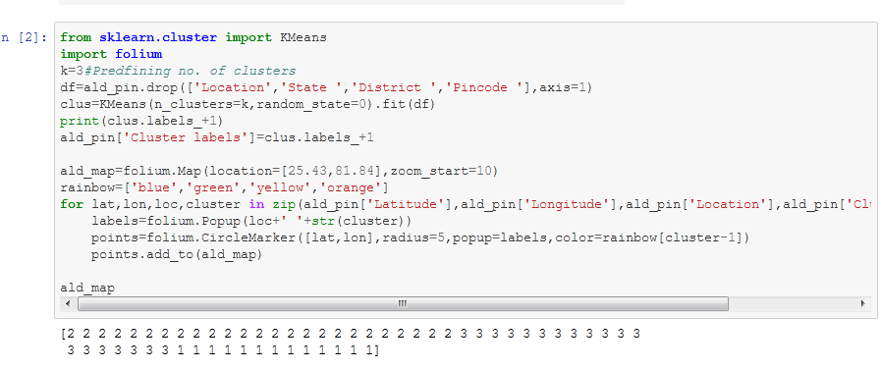
K-Means Clustering

Slide 7
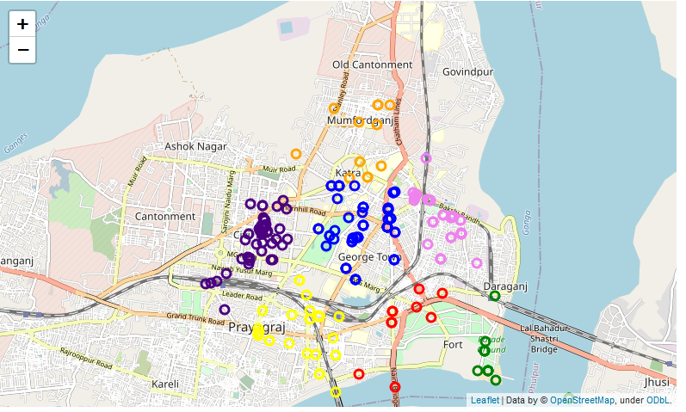
VISUALISATION: MAP

Slide 8
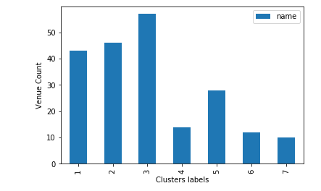
VISUALISATION: BAR PLOT

Slide 9
THANK YOU!

